Slide 1

Lecture 1: Next Generation Sequencing and DNA sequencing
Dr. Findlay Bewicke-Copley

Slide 2
Aims
Understand the basics of Next Generation Sequencing
Learn the files associated with NGS and DNA sequencing
Touch on the different types of DNA sequencing

Slide 3
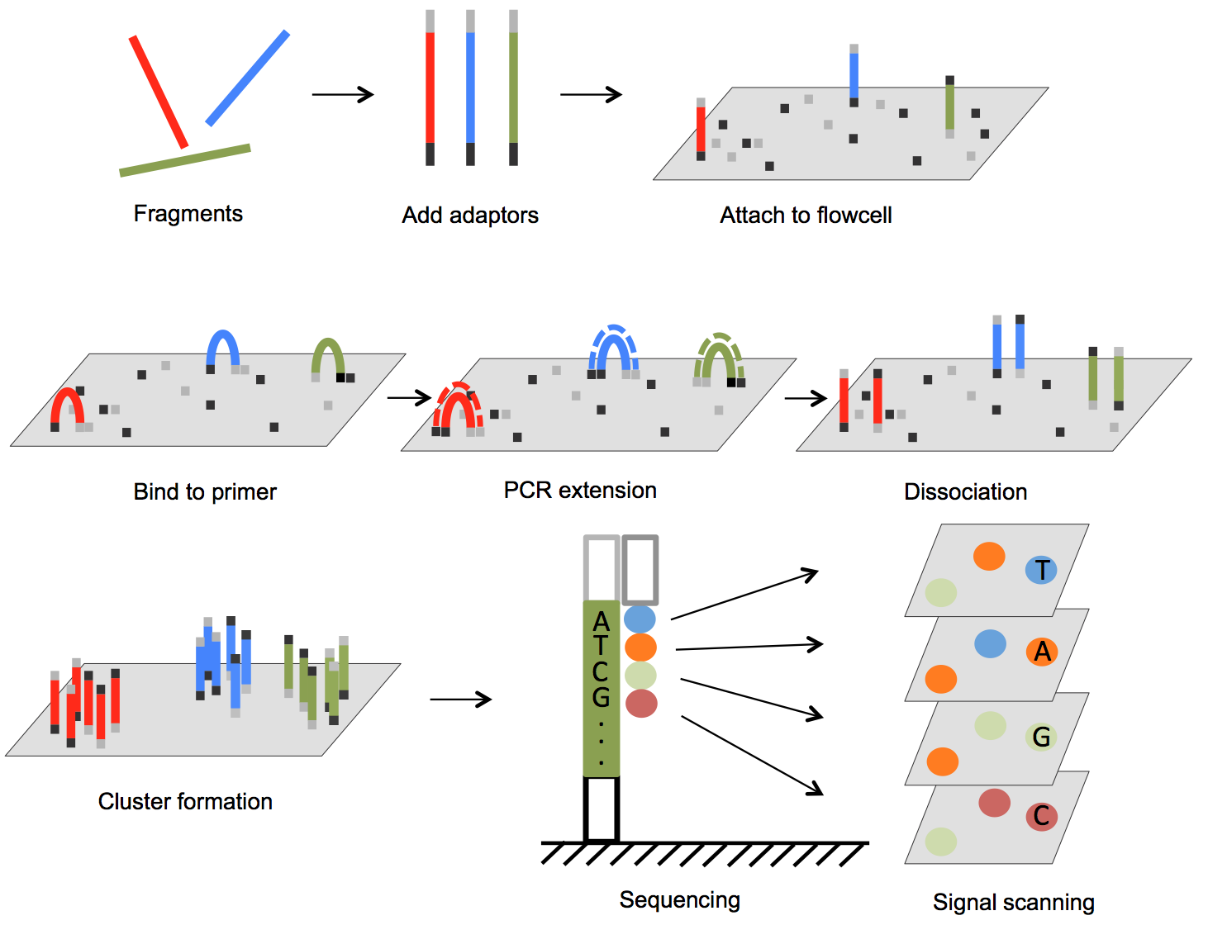
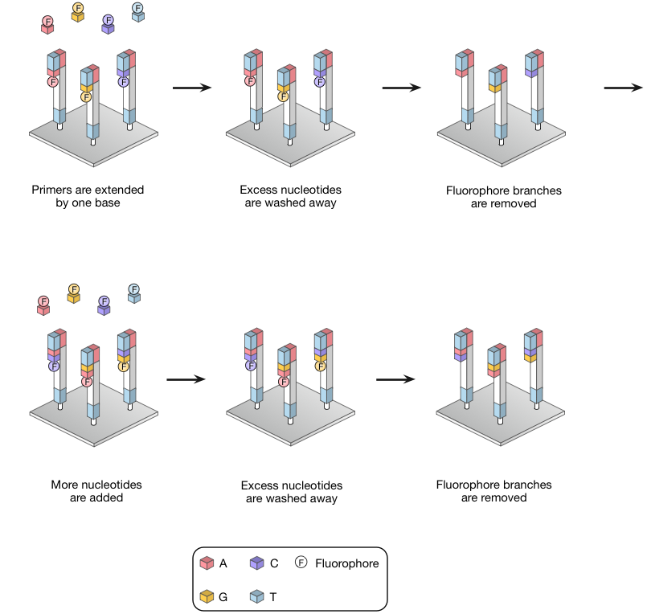
Next Generation Sequencing

Slide 4
File types
FASTA
  Raw sequence information
FASTQ
  Sequencer read information
  Contains read ID, Sequence and base quality scores
Sequence Alignment Map (SAM)
  Stores reads aligned to a genome
  Compressed: Binary Alignment Map (BAM)
Variant Call Format (VCF)
  Contains information on variant calls

Slide 5
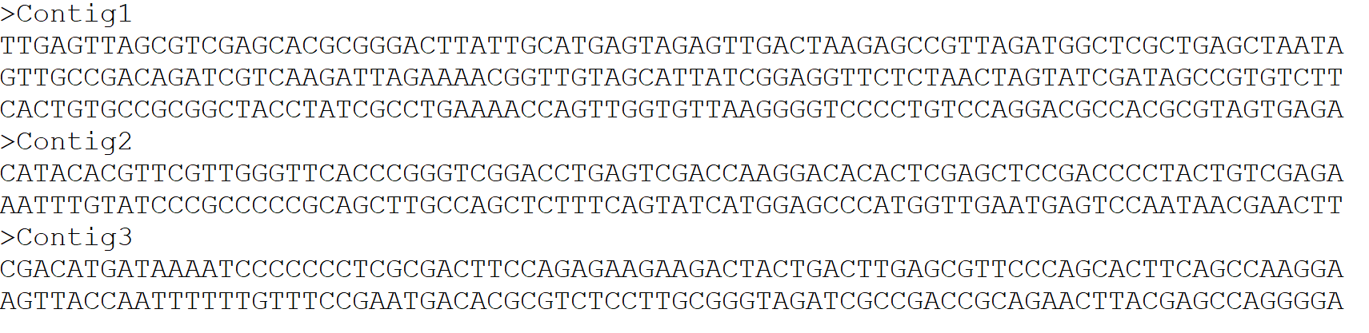
FASTA

Slide 6
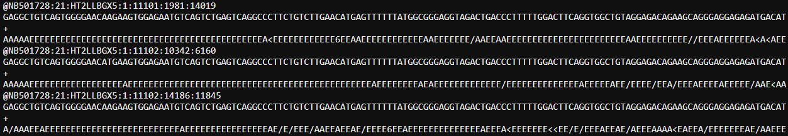
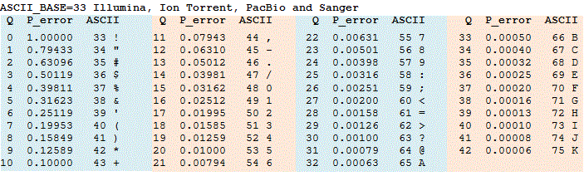
FASTQ

Slide 7
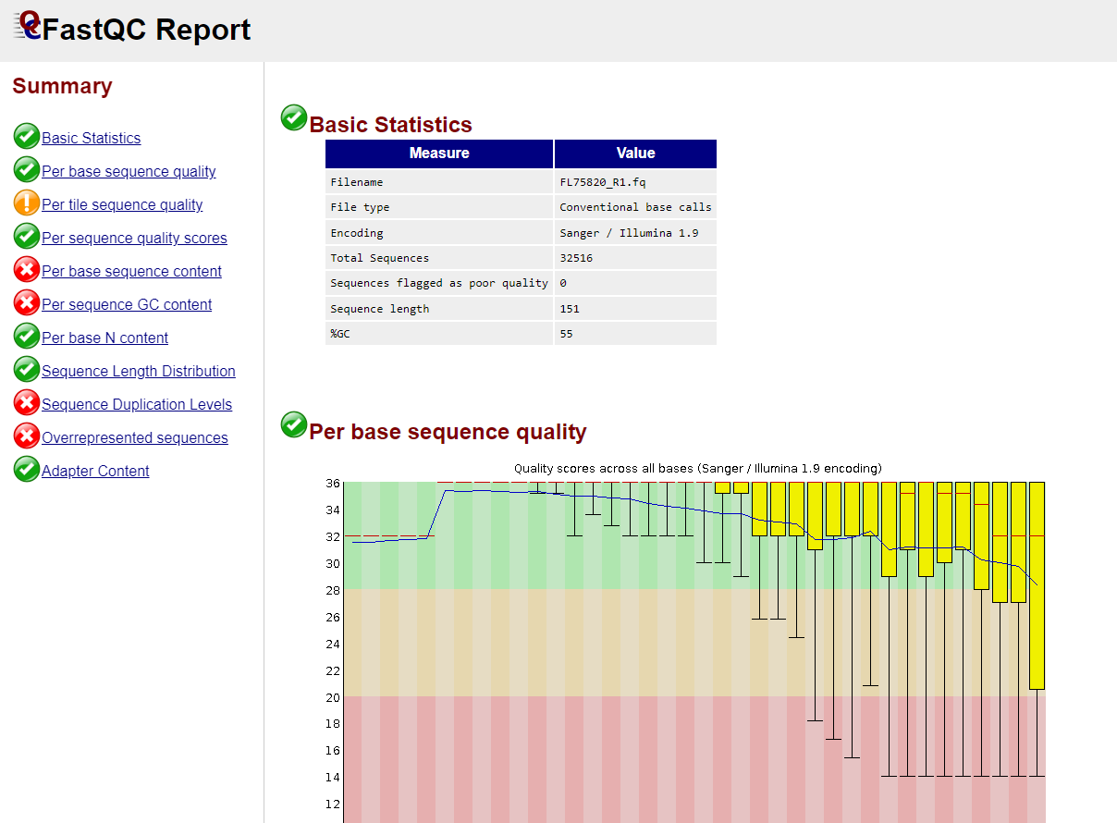
FASTQC

Slide 8
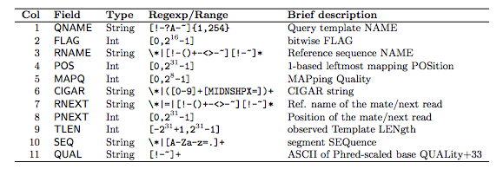
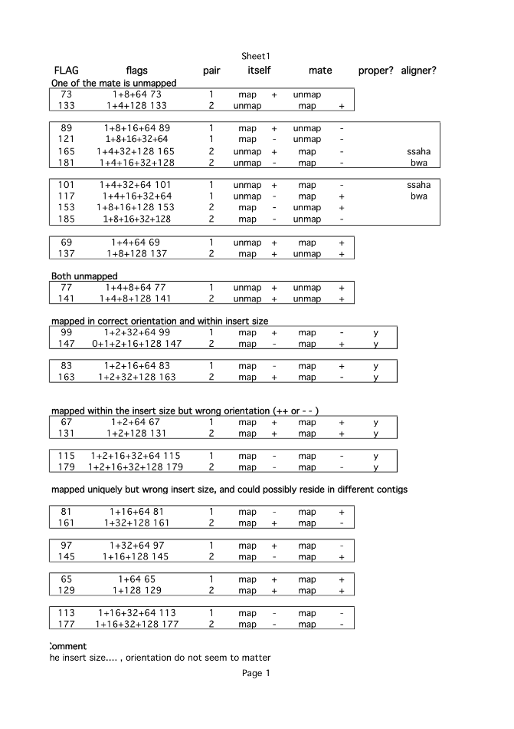
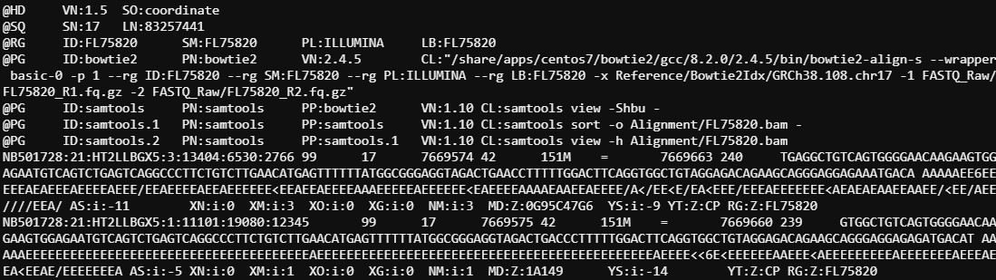
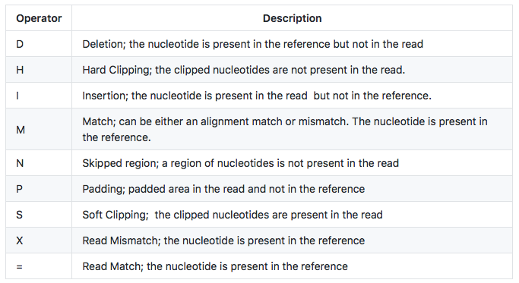
Sequence Alignment Map

Slide 9
Sequence Alignment Map

Slide 10
SAM flags and CIGAR
The flag field of the SAM is a bitwise flag
  This allows tools to very quickly collect statistics about the alignments
The CIGAR field contains information about HOW the read is aligned
  Compact Idiosyncratic Gapped Alignment Report
  Uses letters to indicate how bases are used in the alignments
    M – Match
    N – didn’t align
    D – Deletion
    I – Insertion etc …
  E.g. 75M10N15M would mean the first 75 bases match the reference, the next 10 don’t, then the last 15 do match
  These are usually only used by software downstream, but can help troubleshoot alignment issues.
read paired | 1
read mapped in proper pair | 2
read unmapped | 4
mate unmapped | 8
read reverse strand | 16
mate reverse strand | 32
first in pair | 64
second in pair | 128
not primary alignment | 256
read fails platform/vendor quality checks | 512
read is PCR or optical duplicate | 1024
supplementary alignment | 2048

Slide 11
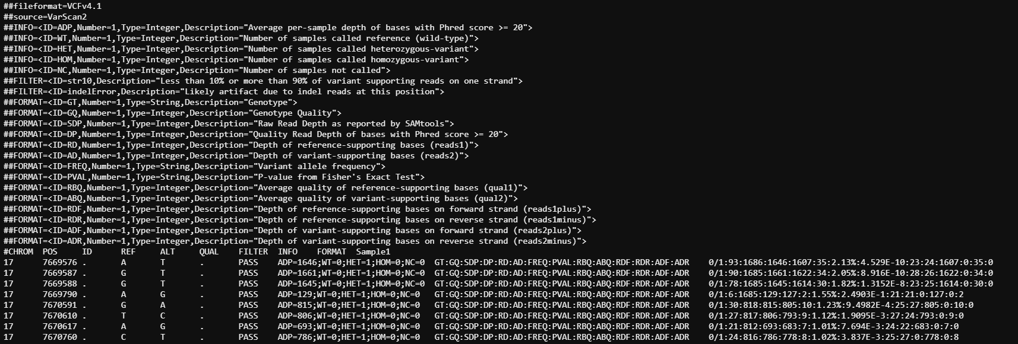
Variant Calling (VCF)

Slide 12
Variant Calling (VCF)

Slide 13
DNA sequencing
Mutations
  Single Nucleotide Variations (SNV)
  Insertions/deletions (indels)
Structural Variants
  Copy Number Variation (CNV)
  Translocations
  Inversions

Slide 14
DNA sequencing
Whole Genome Sequencing (WGS)
  Aims to sequencing all the DNA in a sample
  Only 2% of the genome is thought to code for proteins
  If you’re only interested in coding variants, this means 98% of your WGS is wasted
Whole Exome Sequencing (WES)
  Sequence every region of the genome that codes for protein
  Need to extract these regions from your sample first
Targeted Sequencing
  As above, except you target specific regions of the genome instead

Slide 15
Enrichment methods

Slide 16
Enrichment methods

Slide 17
DNA sequencing example pipeline
Step 1
QC FASTQ files
Step 2
Align to genome
Step 3
Mark duplicates
Step 4
Base Score Quality Recalibration
Step 5
Variant Calling
Step 6
Variant Annotation
Step 7
Variant Filtering

Slide 18
Alignment
Take reads and assign them to regions of the genome
This will generate an unsorted SAM file
  some programs can output a BAM file
A
A
G
T
G
A
C
G
T
T
A
A
G
T
G
C
T
A
C
T
A
G
A
T
T
T

Slide 19
SAM/BAM sorting
Co-ordinate sorted
Read Name
sorted
Quickly return reads from specific locations
Find reads that align close to one another
R1 and R2 next to one another
Alignment location not important

Slide 20
Reference Genomes
There are several versions of the human genome
  Most commonly:
    hg19 (also known as hg37)
    hg38
Difference places will have slightly different notation
  Most importantly chromosome names
    1, 2, 3 etc …
    chr1, chr2, chr3 etc …

Slide 21
Aligning to an index
Alignment tools use custom index files for alignment
  NOT the raw FASTA file
Each alignment tool will generate its own index
  They are not cross compatible
  But once made they can be used for any project
Each genome you want to use needs its own index
Updating software can mean you need to rebuild your index
These tools all come with an indexing tool to do this

Slide 22
PCR duplicates
Reads might represent PCR duplicates, rather than unique reads

Slide 23
PCR duplicates
Reads might represent PCR duplicates, rather than unique reads
Marking duplicates

Slide 24
PCR duplicates
Reads might represent PCR duplicates, rather than unique reads
Marking duplicates
Unique Molecular Identifiers (UMIs)

Slide 25
When to handle duplicates
Some times you expect “duplicates”
  Amplicon sequencing
    You are amplifying fragments from the same sections of DNA
  RNA-sequencing
    Short or highly expressed transcripts often lead to overlapping reads
Other times they need addressed
  Hybrid capture
  UMI-based library preparation

Slide 26
Base Quality Score Recalibration (BQSR)
Base quality scores are important in variant calling
However - sequencing machines often introduce systemic errors
BSQR uses a machine learning model to try and smooth out these issues
BSQR has two steps:
  Building the model
  Applying the adjustments

Slide 27
Genome Analysis Toolkit (GATK)
GATK is a software package
  contains many different tools for NGS analysis
The developers also maintain a set of “best practice” workflows for NGS
We need to use three of these tools for our data preprocessing
  MarkDuplicates (previously available from Picard Tools)
  BaseRecalibrator (build our model for BSQR)
  ApplyBSQR (apply the BSQR model)

Slide 28
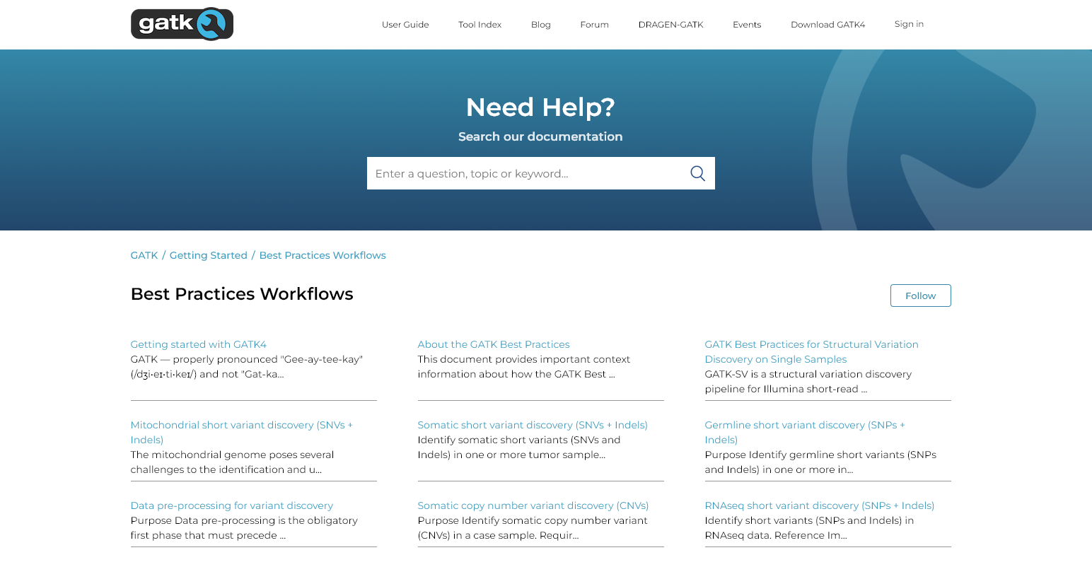
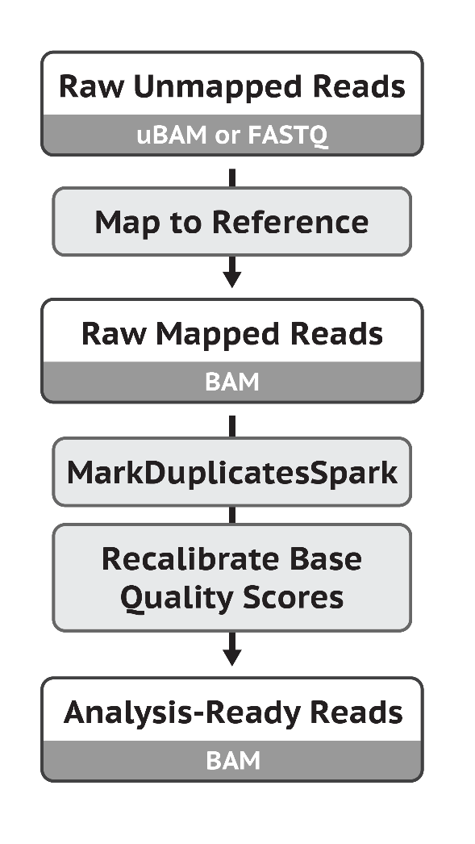
GATK short variant discovery

Slide 29
Summary
Raw reads first need to be aligned to a reference genome
Raw alignment data needs to be further processed prior to variant calling
GATK is a very useful resource for NGS tools and pipelines.

